Slide 1
SOLVER
WORDLE
Intelligence Artificielle II
MIN 1
Evan PASETAU

Slide 2
PROCESS
ÉTUDIÉS/
{01}
{02}
{03}
{04}
L’HUMAIN
ALGORITHME
LOCAL SLM
ONLINE LLM
C’est moi qui ai fait les parties et je ne suis pas très bon.
Un algorithme de qui maximise l’entropie aux premier tours et choisi le mots le plus probable.
Un petit modèle qui tourne en local Gemma3:1b et Llama2.
Les deux modèles Gemini 3 Pro vs ChatGPT 5.

Slide 3
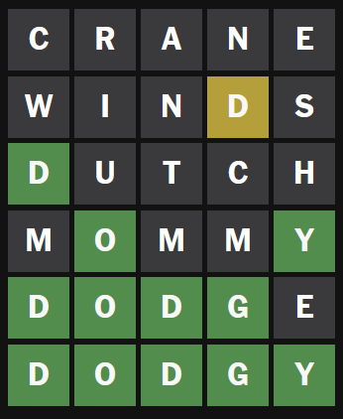
RESULTATS HUMAINS/

Slide 4
Resultats de l’algorithme

Slide 5
Resultats de l’algorithme

Slide 6
02
STRATEGIC VISION & DIRECTION/
PURPOSE FORWARD

Slide 7
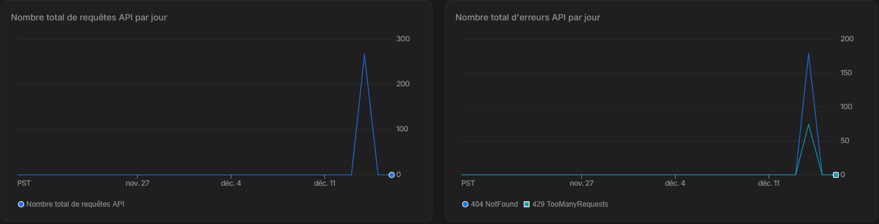

CALLING API/

Slide 8
CALLING API/
Notes:
Je n’ai pu faire que 3% de mots wordle anglais (0% français)

Slide 9
SHAPING DECISIONS TODAY TO EMPOWER TOMORROW’S SUCCESS/
Venus has a beautiful name and is the second planet from the Sun.
Despite being red, Mars is actually a cold place. It’s full of iron oxide dust.

Slide 10
{01}
{02}
{03}
PROJECT
DEPENDENCIES/
Mercury is the closest planet to the Sun and the smallest one in the Solar System. This planet’s name has nothing to do with the liquid metal, since Mercury was named after the Roman messenger god.
Venus has a beautiful name and is the second planet from the Sun. It’s very hot and its atmosphere is extremely poisonous. It’s the second-brightest natural object in the night sky after the Moon.
Jupiter is a gas giant and the biggest planet in the Solar System. It’s the fourth-brightest object in the night sky and it has around eighty moons. It was named after the Roman god of the skies.

Slide 11
REQUIREMENTS/
{01}
{04}
{02}
{05}
{03}
{06}
Mercury is the smallest planet in the Solar System, even smaller than some of the moons of other planets.
Jupiter, the largest planet in the Solar System, is a gas giant. It ranks as the fourth-brightest object in the night sky.
Despite its red appearance, Mars is actually a cold planet. The surface is covered in iron oxide dust.
Saturn is primarily composed of hydrogen and helium, making it a massive gas giant. It has several rings
Venus has a beautiful name and is the second planet from the Sun. Its atmosphere is extremely poisonous.
Neptune is the farthest planet from the Sun in our Solar System. It’s known for its deep blue color.

Slide 12
PHASE COMPLETION STATUS/
{25%}
{50%}
{75%}
Venus has a beautiful name and is the second planet from the Sun
Despite being red, Mars is actually a cold place. It’s full of iron oxide dust
Despite being red, Mars is actually a cold place. It’s full of iron oxide dust

Slide 13
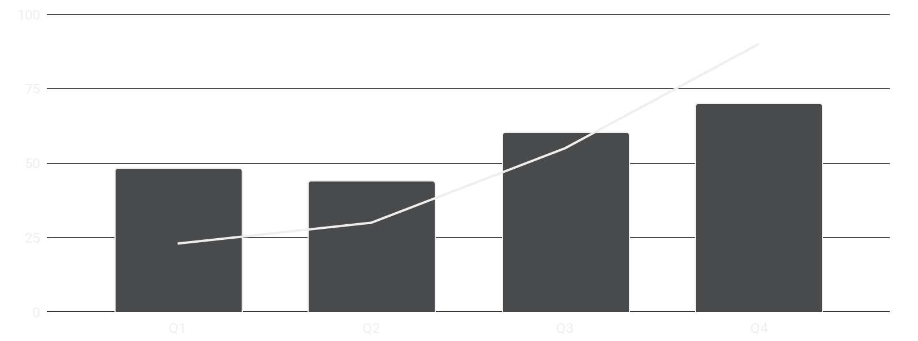
PROGRESS & METRICS DASHBOARD/
PROJECT PHASES | Q1 |  |  | Q2 |  |  | Q3 |  |  | Q4
Phase 01
Phase 02
Phase 03
Phase 04
MERCURY
Mercury is the closest planet to the Sun.
VENUS
Venus is the second planet from the Sun.
Follow the link in the graph to modify its data and then paste the new one here. For more info, click here

Slide 14
THANK YOU/
Es que vous avez des questions ?
PLEASE KEEP THIS SLIDE FOR ATTRIBUTION

